Slide 1
Arduino Programming
We learned that Arduino IDE (Integrated Development Environment) allows us to draw the sketch and upload it to the various Arduino boards using code. The code is written in a simple programming language similar to C and C++. The initial step to start with Arduino is the IDE download and installation.
Let's discuss the basics to start with Arduino programming.
Brackets
There are two types of brackets used in the Arduino coding, which are listed below:
Parentheses ( )
Curly Brackets { }

Slide 2
Parentheses ( )
The parentheses brackets are the group of the arguments, such as method, function, or a code
statement. These are also used to group the math equations.
Curly Brackets { }
The statements in the code are enclosed in the curly brackets. We always require closed curly
brackets to match the open curly bracket in the code or sketch. Open curly bracket- ' { '
Closed curly bracket - ' } '
Line Comment
There are two types of line comments, which are listed below:
Single line comment
Multi-line comment
// Single line comment
The text that is written after the two forward slashes are considered as a single line comment. The compiler ignores the code written after the two forward slashes. The comment will not be displayed in the output. Such text is specified for a better understanding of the code or for the explanation of any code statement. The // (two forward slashes) are also used to ignore some extra lines of code without deleting it.

Slide 3
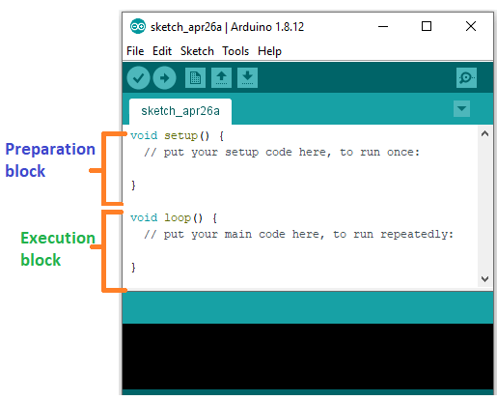
/ * Multi - line comment */
The Multi-line comment is written to group the information for clear understanding. It starts with
the single forward slash and an asterisk symbol (/ *). It also ends with the / *. It is commonly used to write the larger text. It is a comment, which is also ignored by the compiler.
Coding Screen
The coding screen is divided into two blocks. The setup is considered as the preparation block,
while the loop is considered as the execution block. It is shown below:

Slide 4
The set of statements in the setup and loop blocks are enclosed with the curly brackets. We can write multiple statements depending on the coding requirements for a particular project.
For example,
1. void setup ( )
2. {
Coding statement 1;
Coding statement 2;
.
6. .
7. .
8. Coding statement n;
9. }

Slide 5
10. void loop ( )
11. {
12. Coding statement 1;
13. Coding statement 2;
14. .
15. .
16. .
17. Coding statement n;
18. }

Slide 6
What is Setup? What type of code is written in the setup block?
It contains an initial part of the code to be executed. The pin modes, libraries, variables, etc., are
initialized in the setup section. It is executed only once during the uploading of the program and after reset or power up of the Arduino board.
Zero setup () resides at the top of each sketch. As soon as the program starts running, the code
inside the curly bracket is executed in the setup and it executes only once.
Syntax
Syntax in Arduino signifies the rules need to be followed for the successful uploading of the
Arduino program to the board. The syntax of Arduino is similar to the grammar in English. It
means that the rules must be followed in order to compile and run our code successfully. If we break those rules, our computer program may compile and run, but with some bugs.

Slide 7
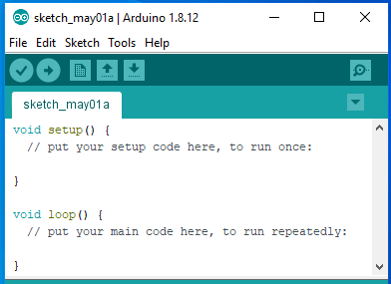
Let's understand with an example.
As we open the Arduino IDE, the display will look like the below image:

Slide 8
The two functions that encapsulate the pieces of code in the Arduino program are shown below:
void setup ( )
void loop ( )
Functions
The functions in Arduino combine many pieces of lines of code into one.
The functions usually return a value after finishing execution. But here, the function does not return any value due to the presence of void.
The setup and loop function have void keyword present in front of their function name.
The multiple lines of code that a function encapsulates are written inside curly brackets.
Every closing curly bracket ' } ' must match the opening curly bracket '{ ' in the code.
We can also write our own functions, which will be discussed later in this tutorial.

Slide 9
Spaces
Arduino ignores the white spaces and tabs before the coding statements.
The coding statements in the code are intent (empty spacing at the starting) for the easy reading.
In the function definition, loop, and conditional statements, 1 intent = 2 spaces.
The compiler of Arduino also ignores the spaces in the parentheses, commas, blank lines, etc.
Tools Tab
The verify icon present on the tool tab only compiles the code. It is a quick method to
check that whether the syntax of our program is correct or not.
To compile, run, and upload the code to the board, we need to click on the Upload button.
Uses of Parentheses ( )
It denotes the function like void setup ( ) and void loop ( ).
The parameter's inputs to the function are enclosed within the parentheses.
It is also used to change the order of operations in mathematical operations.

Slide 10
Semicolon ;
It is the statement terminator in the C as well as C++.
A statement is a command given to the Arduino, which instructs it to take some kind of action. Hence, the terminator is essential to signify the end of a statement.
We can write one or more statements in a single line, but with semicolon indicating the end of each statement.
The compiler will indicate an error if a semicolon is absent in any of the statements.
It is recommended to write each statement with semicolon in a different line, which makes the code easier to read.
We are not required to place a semicolon after the curly braces of the setup and loop
function.
Arduino processes each statement sequentially. It executes one statement at a time before moving to the next statement.

Slide 11


Program Flow
The program flow in Arduino is similar to the flowcharts. It represents the execution of a
program in order. We recommend to draw the flowchart before writing the code. It helps us to understand the concept of code, which makes it the coding simpler and easier.
Flow Charts
A flowchart uses shapes and arrows to represent the information or sequence of actions. An oval
ellipse shows the Start of the sequence, and a square shows the action or processes that need to be performed.
The Arduino coding process in the form of the flowchart is shown below:
Here, the processor enters our code, and the execution of code begins. After the setup, the execution of the statement in the loop begins.

Slide 12
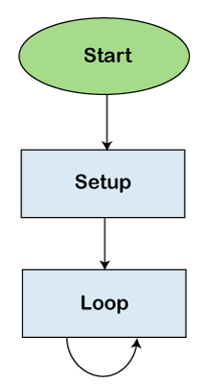
The example of the flowchart in Arduino is shown below:

